Slide 1

Pearl Lower Elementary
2022 – 2023
Open House
“We’re Wild About Learning!”
Title I Meeting

Slide 2
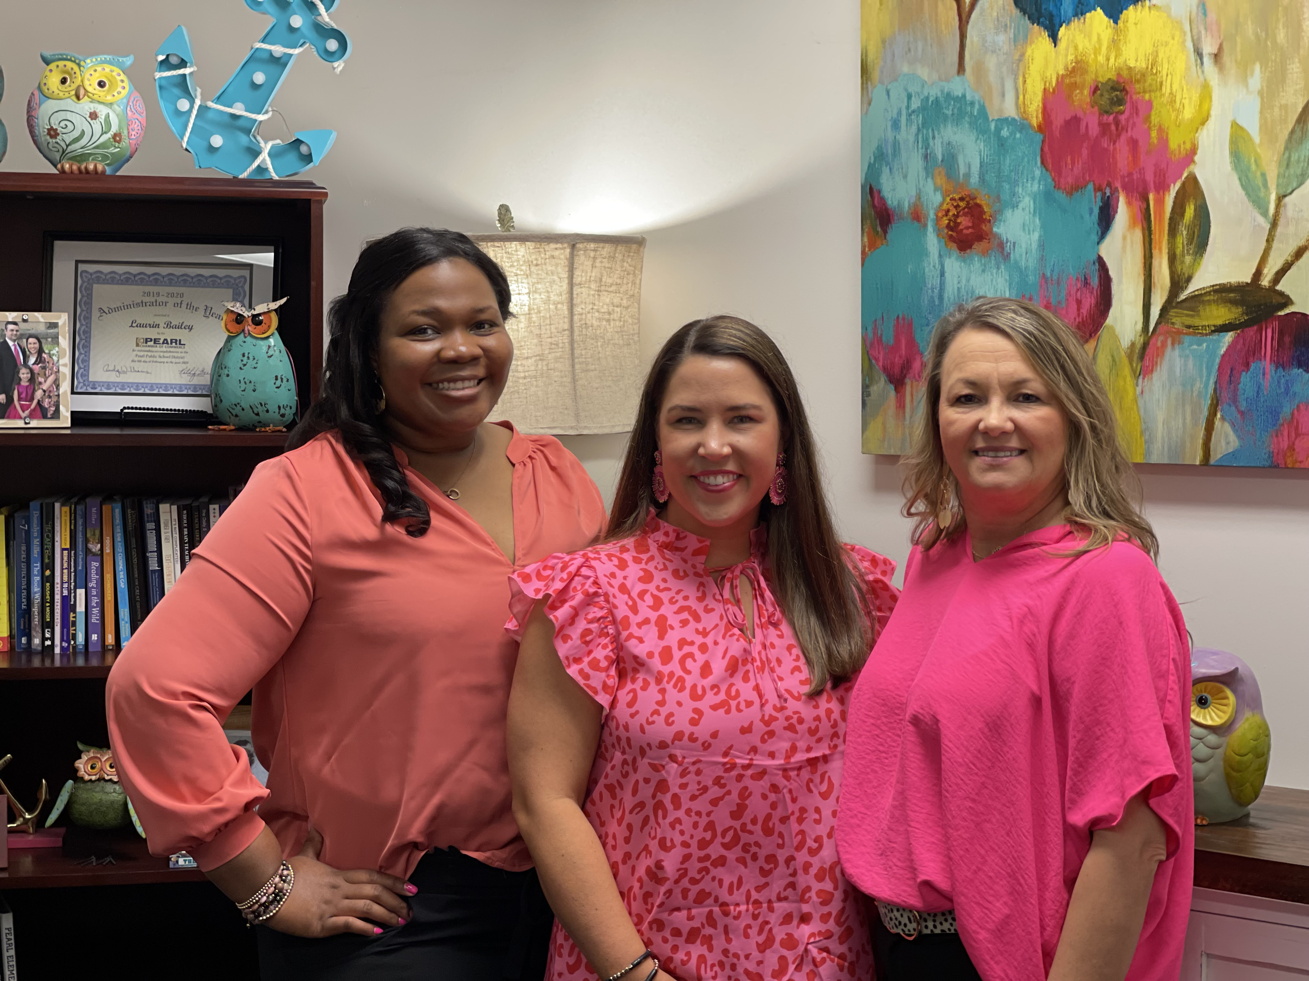
Pearl Lower Administration Team
Dr. Tamekia Stewart Dr. Laurin Bailey Missy Jones
Assistant Principal Principal Assistant Principal

Slide 3
Performance Goals
01
02
Grow Every Student
Top 10% in the state for MKAS
03
04
Student ADA 95% or higher
- Every kindergarten student entering first grade a ready reader.
- Every first grader entering 2nd grade reading 60 – 80 correct words per minute.

Slide 4
How do we plan to meet these goals?
Build Relationships
Set High Academic Standards
High quality classroom instruction and assessments
-Intervention
-Enrichment

Slide 5
Title I School
Title Money Funds:
-Interventionist
-EL teacher
-Instructional Resources and Supports
-Take Home Resources
-Supplies and Materials for Classrooms
-Communication Folders

Slide 6
We Need Your Help!
-Review the Family-School Compact
PLE Goals
Teacher Role
Parent Role
Student Role
-Review and Comment on the Parental Engagement Policy
-Complete the Parental Involvement Survey

Slide 7

Car Rider Information
The car rider line begins at 6:55 each morning and ends at 7:30. Any student arriving to school after 7:30 by car is considered tardy. Tardies are taken in the cafeteria. Please walk your child inside and sign them in.
Car rider students must be at school by 7:20 am to eat breakfast in the cafeteria.

Slide 8

Bus Transportation
Students may only ride one PPSD bus.
All transportation changes must be made in writing and approved by an administrator.
This Photo by Unknown Author is licensed under CC BY-NC

Slide 9

Early Dismissal
If you wish to check your child out early, please do so by 1:30 on Monday, Tuesday, Thursday, & Friday and 1:00 on Wednesday.

Slide 10
Absence Excuses – please send a doctor’s excuse or parent note to school with your child when they return to school from being absent.
Money - please label a bag or envelope with your child’s first and last name and teacher’s name when sending money or lunch money to school.

Slide 11
Communication is Key!
01
02
03
04
Communication Folder
PLE Text Alerts
Email or Call your Teacher
PPSD Social Media

Slide 12
Pirate PRIDE
Rule #2
Rule #3
Rule #1
Keep your hands and feet to yourself at all times.
If you can’t say anything nice, don’t say anything at all.
Do what your teacher tells you to do the first time.

Slide 13
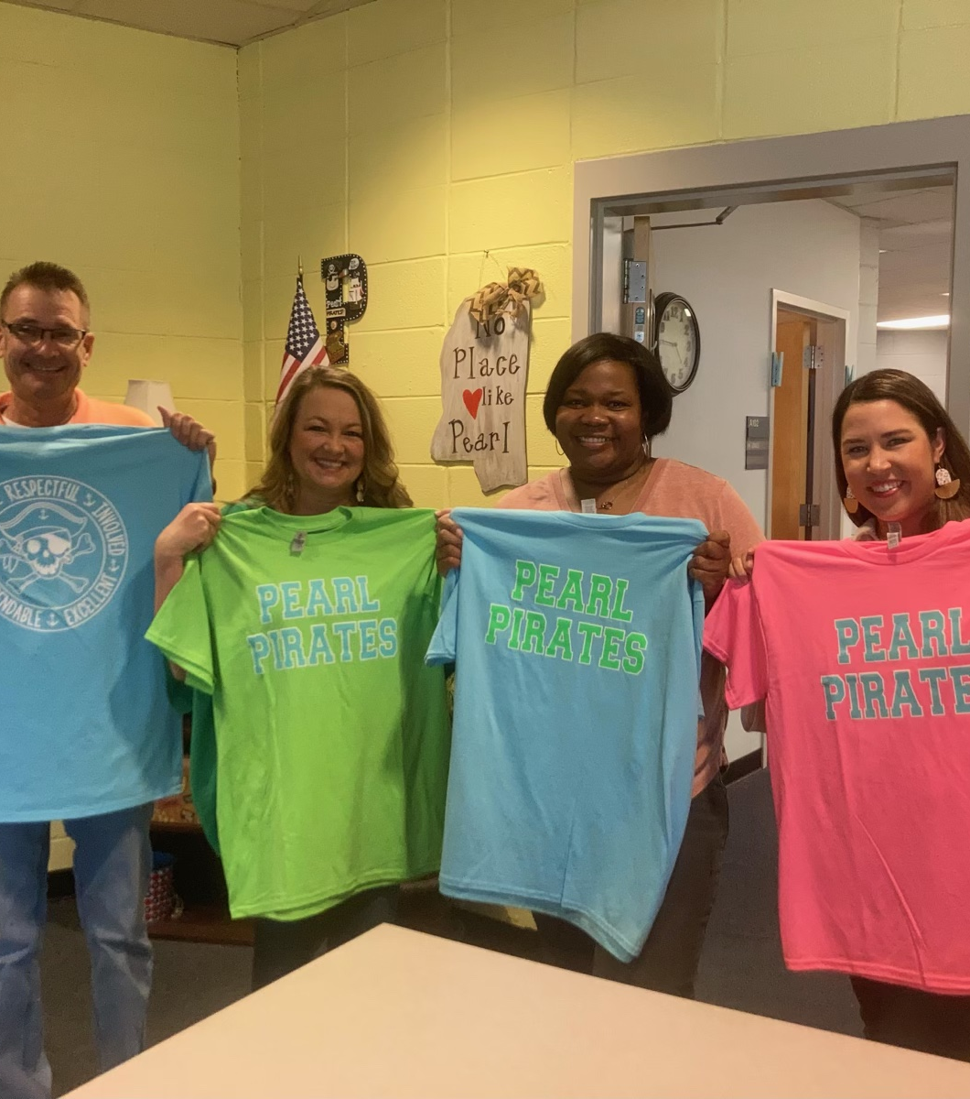

PRIDE
Shirts
Child sizes -$12
Adult sizes - $16
Stop by and purchase at the PTSO table today.

Slide 14
IT’S A GREAT DAY TO BE A PIRATE!

